Slide 1
Spotify Data Analysis
Using Power BI

Slide 2
Project Overview
Power BI Project: Spotify Listening Patterns Analysis
Understanding how users engage with music over time.
Identifying trends in album, artist, and track listening patterns.
Helping streaming platforms make data-driven decisions.

Slide 3
Key Insights
Key Insights from the Analysis
Total Albums, Artists & Tracks Played Over Time – Track listening trends.
Weekday vs Weekend Listening Patterns – Identify behavioral shifts.
Top 5 Albums, Artists & Tracks – Most played content.
Year-over-Year Growth Analysis – Compare latest vs previous year trends.
Listening Hours Heatmap – Spot peak engagement times.
Quadrant Analysis for Track Engagement – Categorize tracks based on listening time vs frequency.

Slide 4
Power BI Features Used
Power BI Tools & Techniques
Data Modeling & Cleaning – Structuring raw data for analysis.
DAX Calculations – Advanced metrics for deeper insights.
Drill-Through & Hierarchical Navigation – Interactive data exploration.
Heatmaps, Scatter Plots & Interactive Dashboards – Engaging visual storytelling.

Slide 5
Spotify Listening Trends – Power BI Dashboard
Overview:
Objective: Analyzing Spotify user listening patterns for albums, artists, and tracks.
Key Metrics:
Albums Played: 7,907 (-21.82% YoY) | Top Album: The Beatles (2,063 plays)
Artists Played: 4,112 (-26.39% YoY) | Top Artist: The Beatles (13.6K plays)
Tracks Played: 13,665 (-11.49% YoY) | Top Track: "Ode to the Mets" (207 plays)
Insights & Trends:
Listening Behavior:
More engagement on weekends (~63%)
Declining music consumption in 2024
Actionable Steps:
Personalized recommendations to retain users
Weekend-focused promotional campaigns
Expand analysis by platform & device

Slide 6
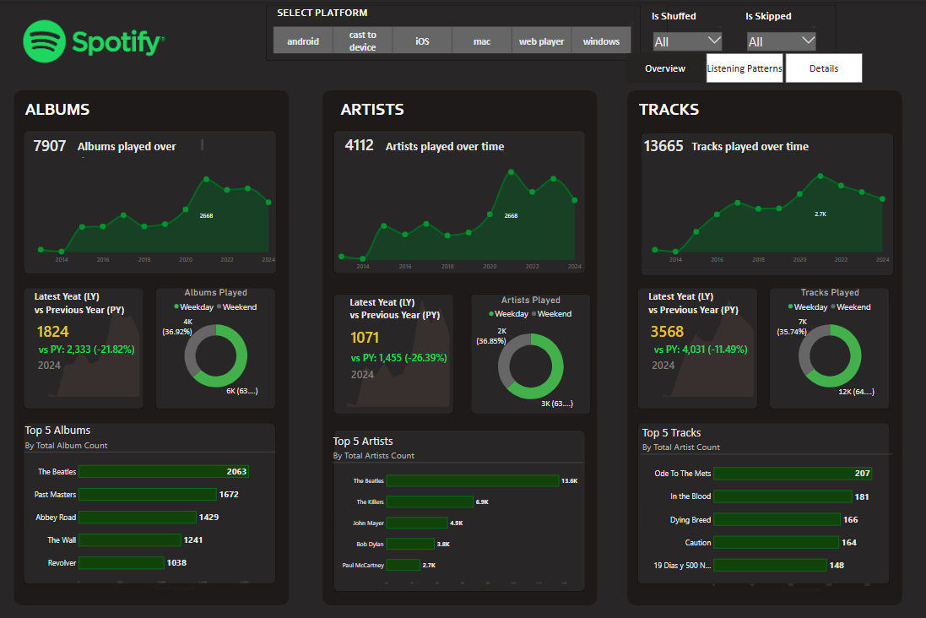

Slide 7
Spotify Listening Patterns: Hours & Track Frequency
Key Insights:
Listening Hours vs. Days (Heatmap on Left):
High activity around midnight and evening hours.
Sundays and late-night hours show increased listening time.
Average Listening Time vs. Track Frequency (Scatter Plot on Right):
Majority of tracks have low average listening time.
Highly played tracks (green) tend to have a longer listening duration.
Filters (Top Right):
Users can filter by year, shuffle mode, and skipped tracks.
Actionable Insights:
Peak Listening Hours: Target personalized recommendations for late-night listeners.
Track Retention: Identify tracks with high frequency but low listening time to improve engagement.
Skip & Shuffle Behavior: Further analyze how these factors impact listening duration.

Slide 8
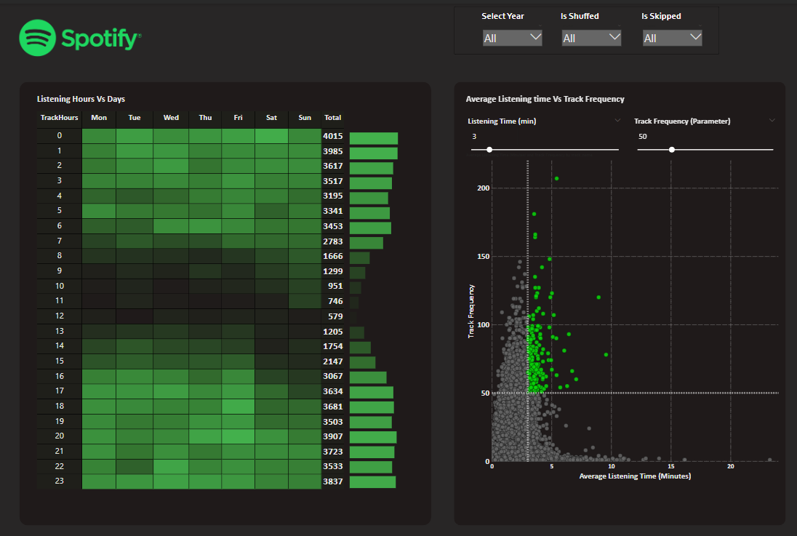

Slide 9
Spotify Album Playback Analysis
Overview: A drill-through matrix for analyzing album playback data.
Drill-Through Levels:
Album → Artist → Track → Platform → Date
Key Metrics:
Albums, Artists, Tracks
Total Play Time (ms)
Avg. Listening Time (min)
The table provides an album-wise breakdown to understand listening patterns on Spotify.

Slide 10
